Slide 1
C300 Final Evaluation
Project ID:
<Redacted>
Project Title:
Implementation of Security Infrastructure on the Cloud
Team ID:
<Redacted>
Team Members:
1. MUHD WAFIYUDDIN BIN ABDUL RAHMAN
2.NG ZI RUI
3.QAMARRUL DANIAL B RAZALI

Slide 2
Overview
Introduction of project
Project specification
Website demonstration
System design (Use Case Diagram)
Database showcase
System design (ERD diagram)
AWS architecture diagram
Cloud security implementation
Monitoring
Allocation of privileges
Task allocation and progress
Records of team meetings with supervisor

Slide 3

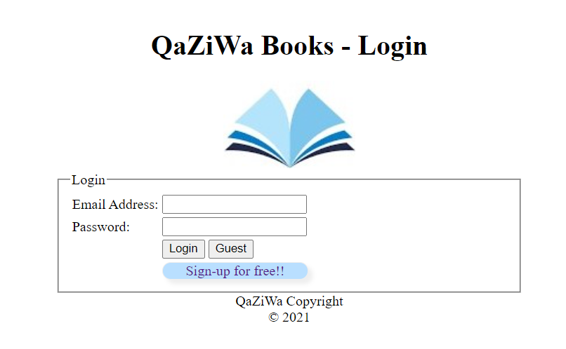
Introduction
Design a cloud infrastructure and deploy it ensuring it achieves similarities such as the traditional 3 tier web application (Web Tier, Application Tier and Database Tier) with security implementations put into place such as auto-scaling and application security. Cloud Infrastructure would be created through AWS cloud.

Slide 4
Project Specification
Deploy a Virtual Private Cloud (VPC); ✔️
Design and deploy a 2 tiers architecture on Cloud (Web-App Tier and DB Tier); ✔️
Web-App tier uses apache web server and PHP application while Database tier uses MySQL. Use XAMPP software for the various tiers. ✔️
Encrypt data in transit (using HTTPS) and data at rest; ✔️
Set up the necessary security groups and IAM groups/users/roles; ✔️
Deploy auto-scaling for Web-App tier; ✔️
Develop a simple web service where read and write to the database are applicable; ✔️
Backup and restoration of MySQL database using manual snapshot for Elastic Block Store (EBS); Store the EBS snapshot on AWS Simple Storage Service (S3).✔️
Use AWS CloudTrail to monitor activities in the VPC. ✔️
Use AWS Security Hub to secure the cloud infrastructure.

Slide 5
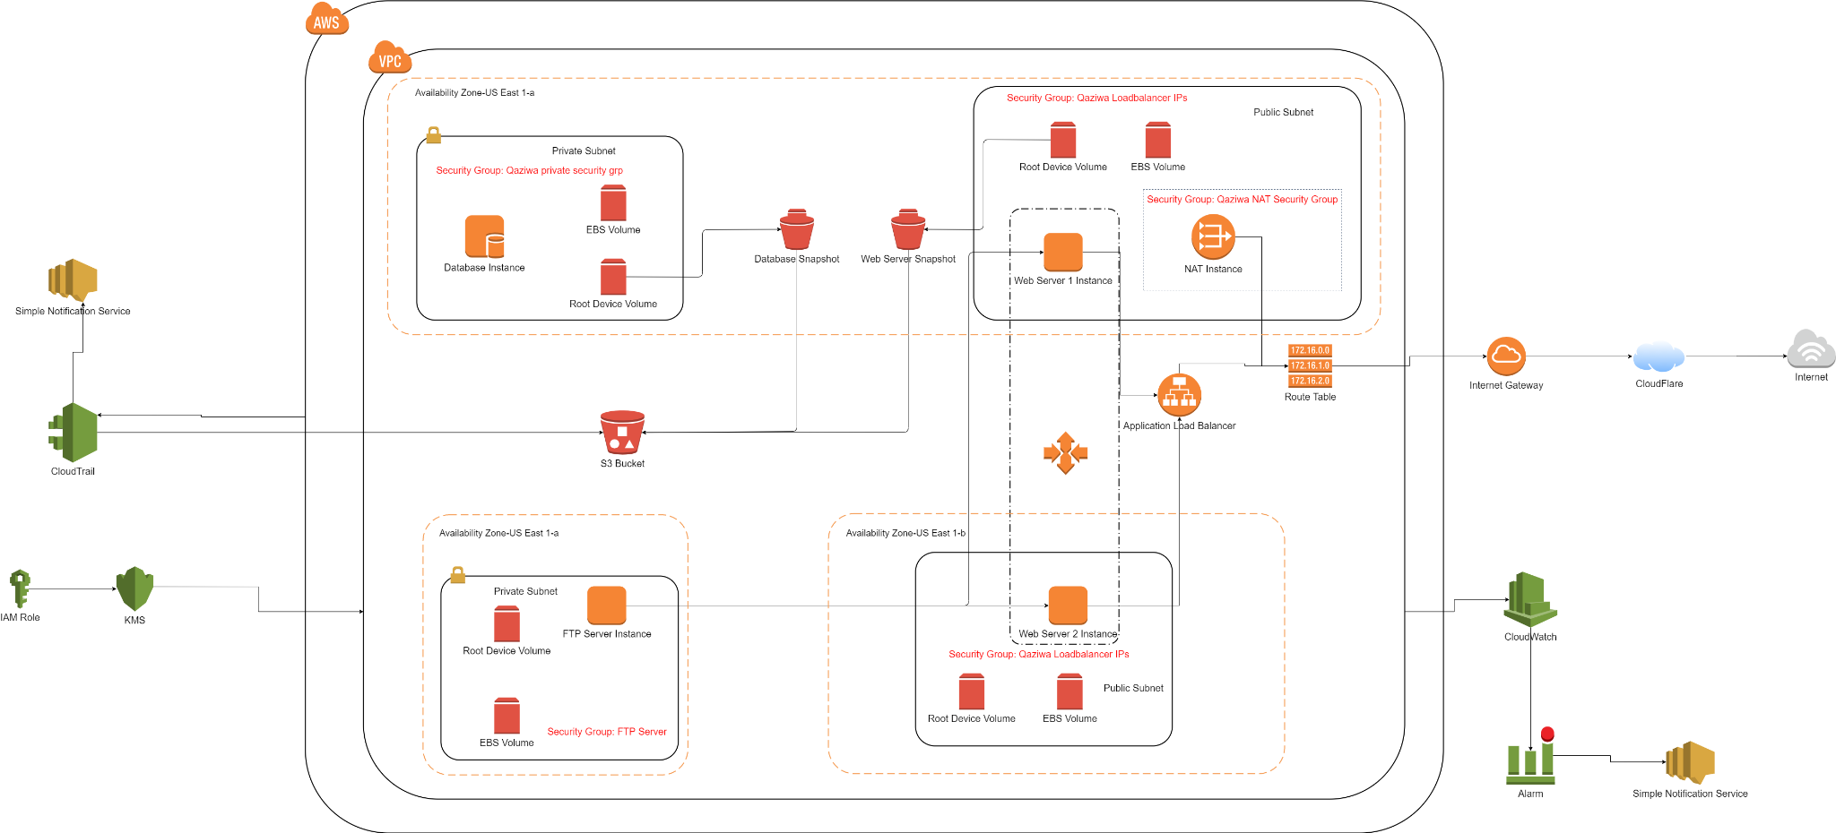
AWS architecture diagram
Presentation Note: Present via Image file for clarity
Notes:
Presentation Note: Present via Image file for clarity

Slide 6
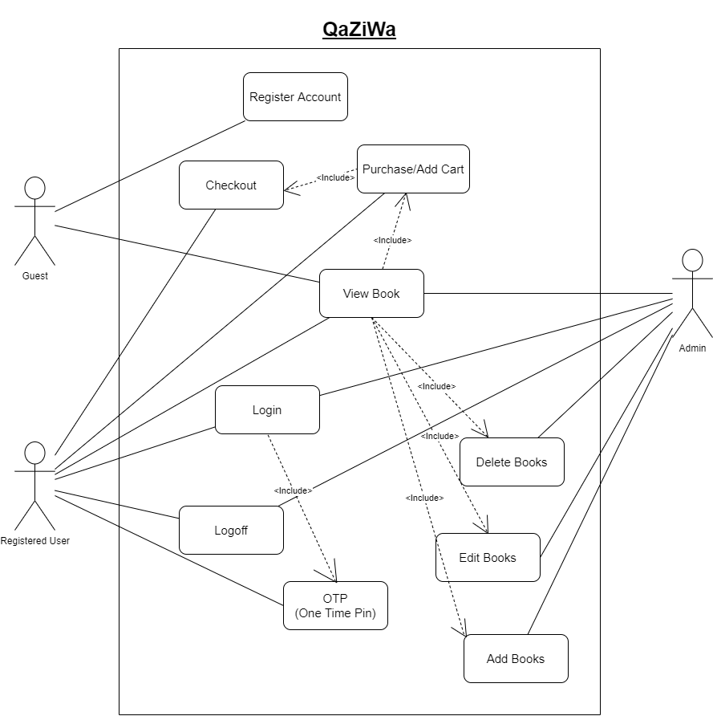
System Design (Use Case Diagram)
3 Users (Registered User, Admin, Guest)
Admin has the most access
Only admin can delete, add and edit books
Guest has the least access
A guest user can become a registered user

Slide 7
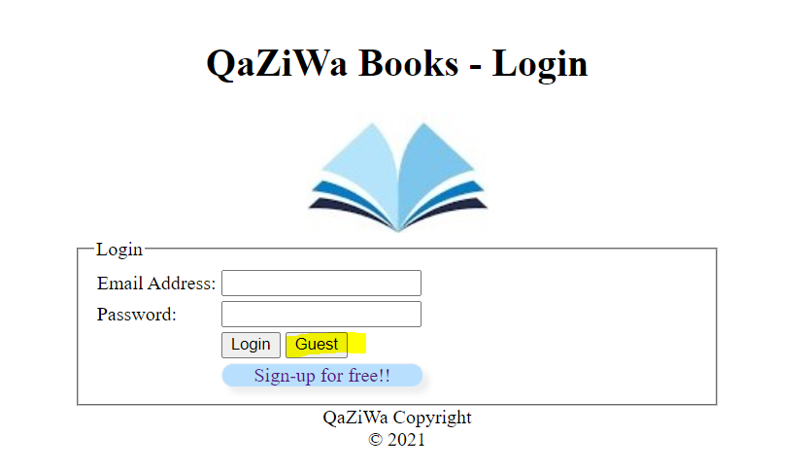
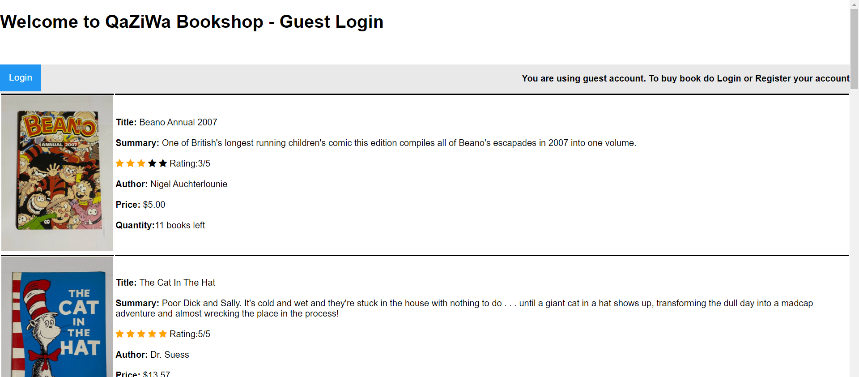
Website/Web Server Demonstration
Our website contain User, Admin and Guest account
Objective: A book selling website.
Showcase of Guest Account:
Privileges: View books only

Slide 8
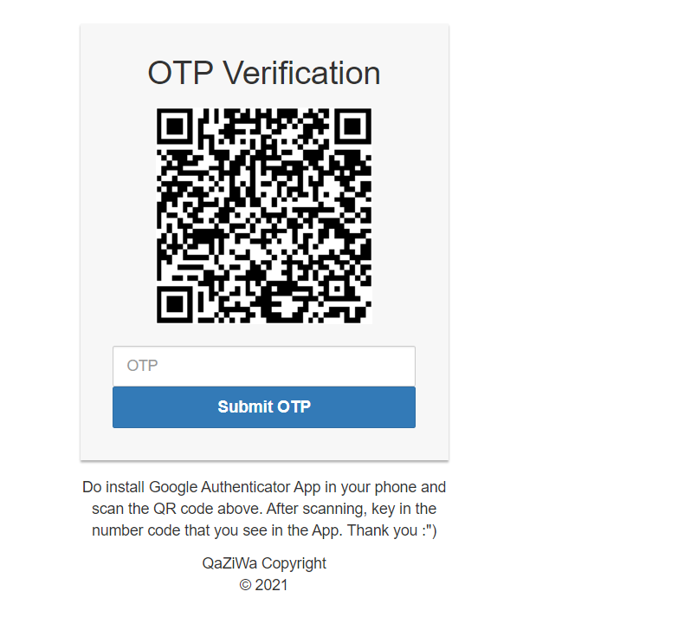
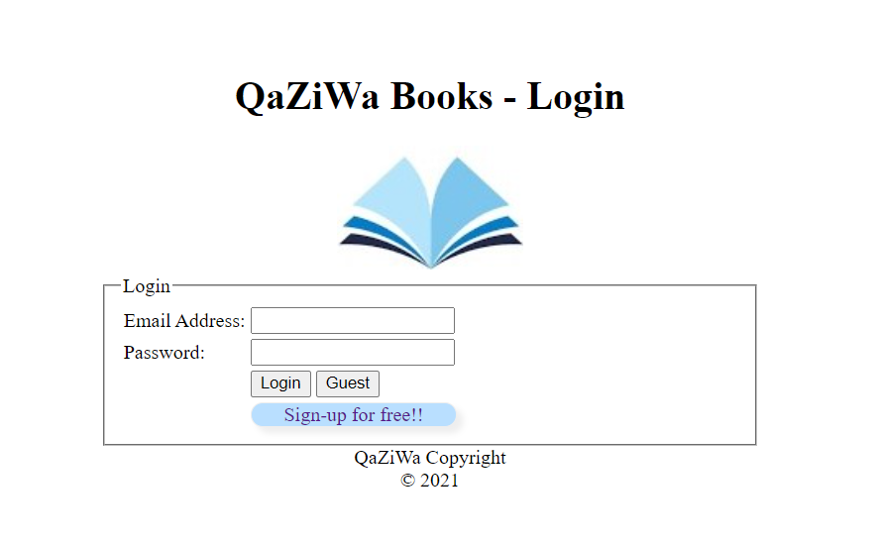
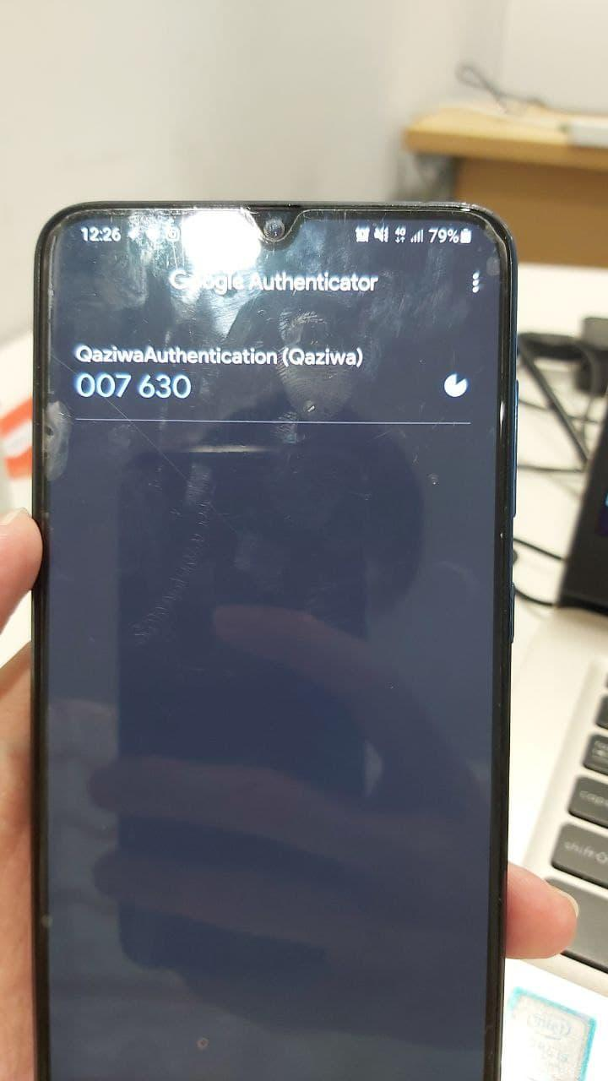
Website/Web Server Demonstration
Showcase of User Account:
Privileges: View books & Buy books only

Slide 9
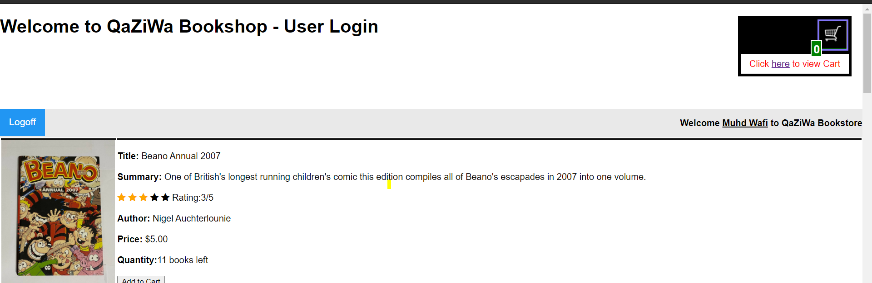
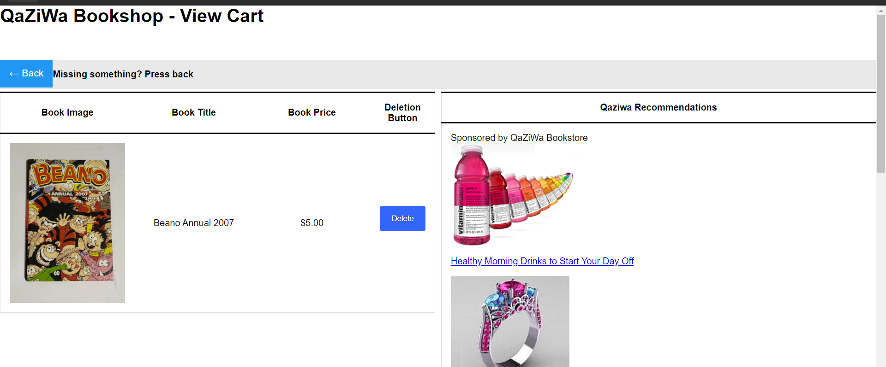
Website/Web Server Demonstration

Slide 10
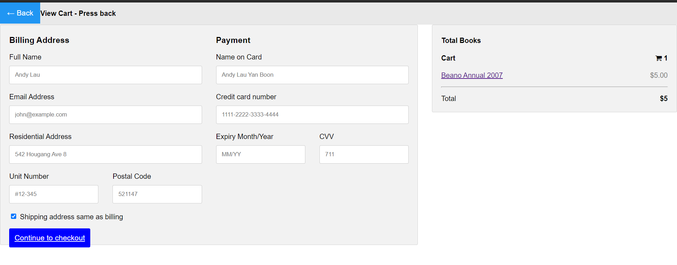
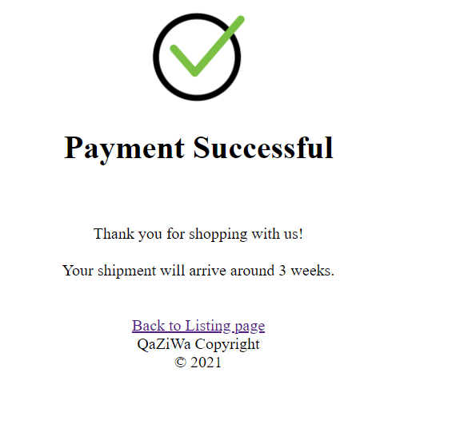
Website/Web Server Demonstration

Slide 11
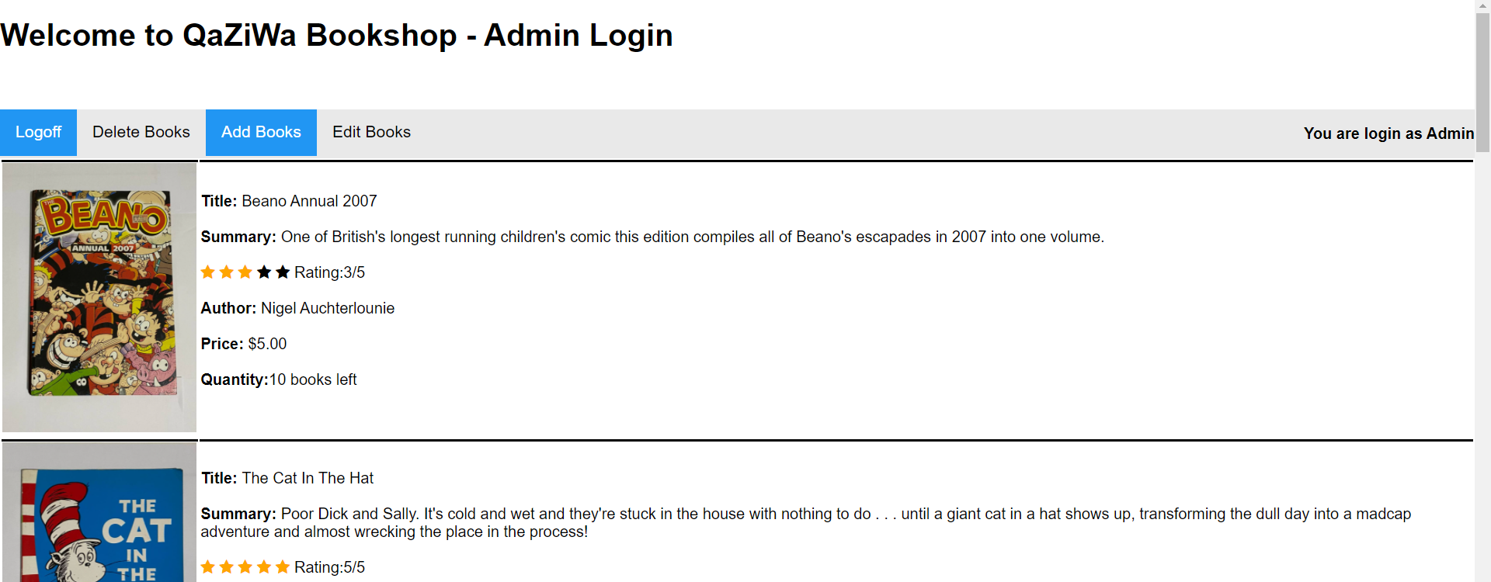
Website/Web Server Demonstration
Showcase of Admin Account:
Privileges: View, Edit, Delete, Add books

Slide 12
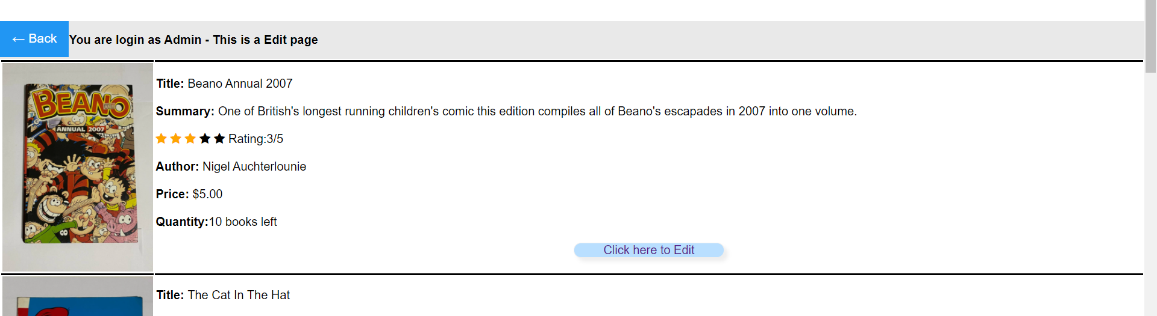
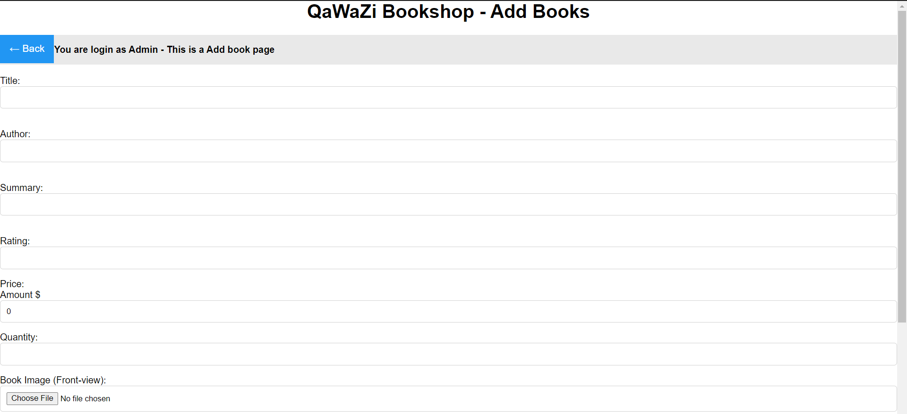
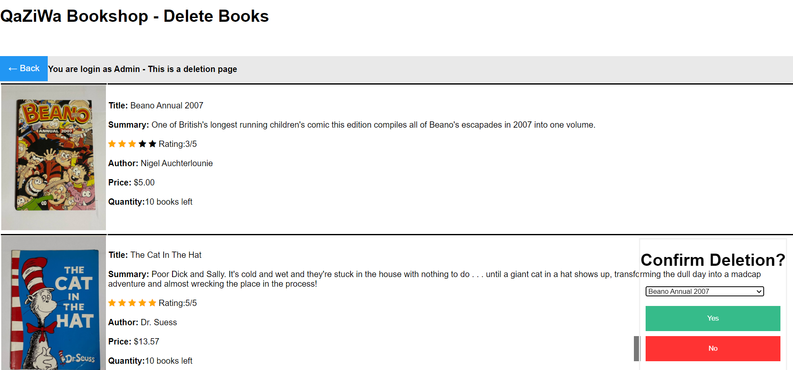
Website/Web Server Demonstration

Slide 13
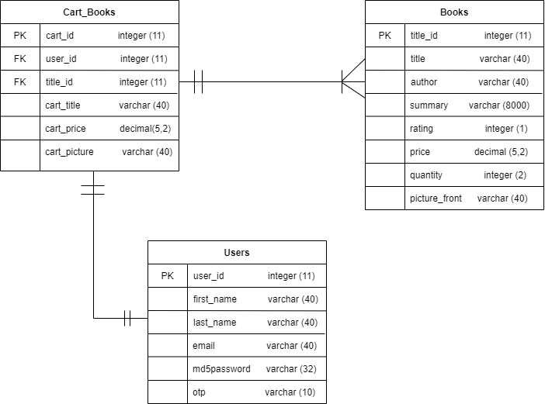
System Design (ERD Diagram)
3 tables total (Books, Users, Cart_Books)
Cart_Books takes data from both Books and Users
Both Users and Books can have their contents added.
Any password in the database is immediately md5 hashed

Slide 14
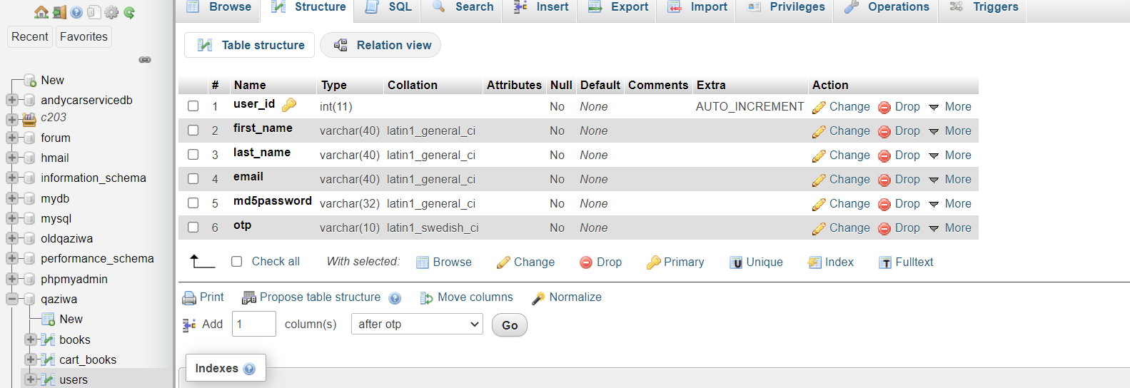
Database Showcase
Database name: Qaziwa
Contains users, books, cart_books tables
user table

Slide 15
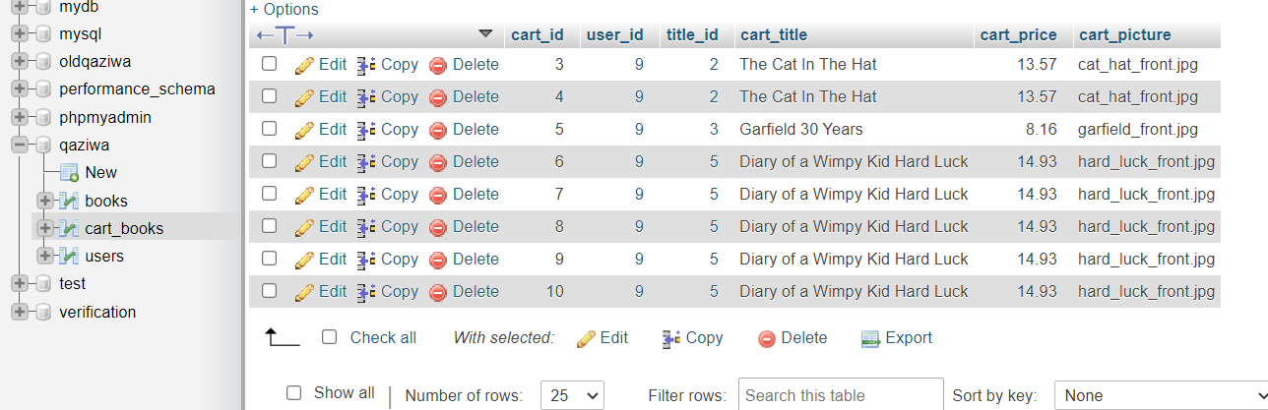
Database Showcase
cart_books table

Slide 16
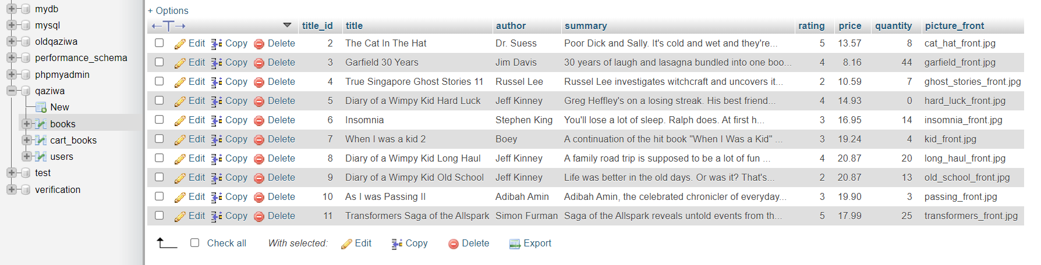
Database Showcase
Books table
Stores all the values for books

Slide 17
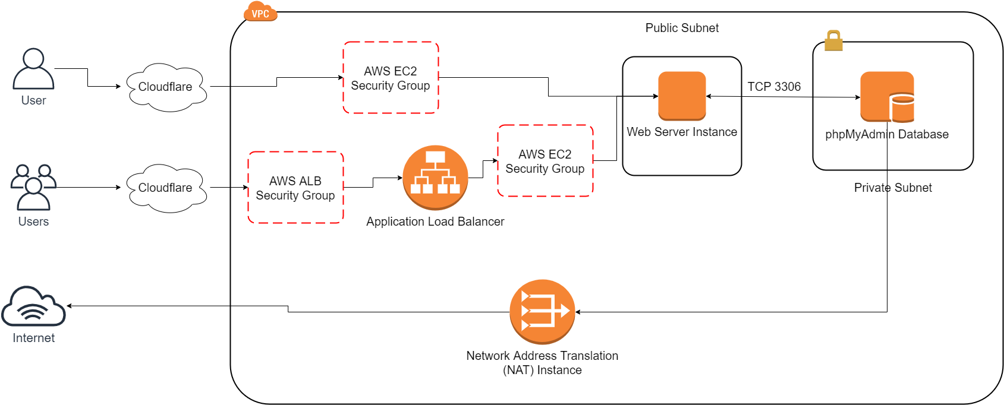
User Access Structure (Summary)
Notes:
Presentation Note: Present via Image file for clarity

Slide 18
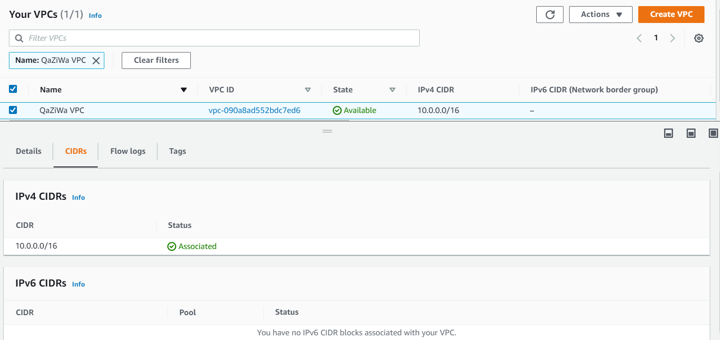
Cloud implementation (AWS educate)
VPC

Slide 19
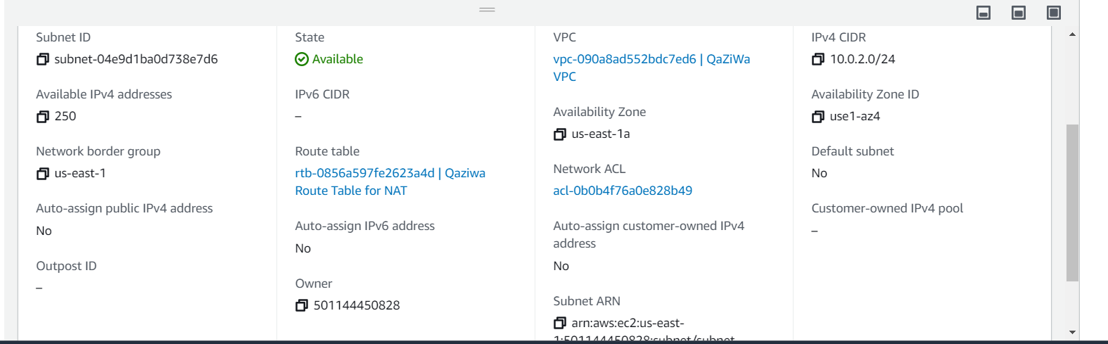
Cloud implementation (‘cont)
2. Subnets
Private subnet

Slide 20
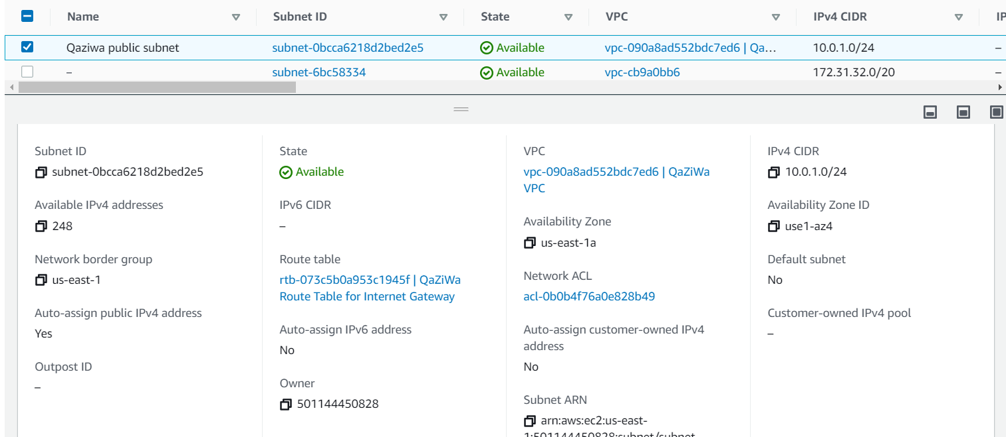
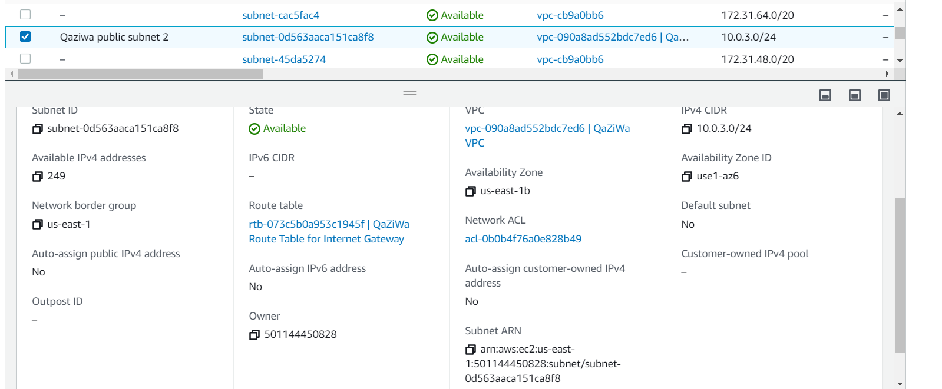
Cloud implementation (‘cont)
Public subnets

Slide 21
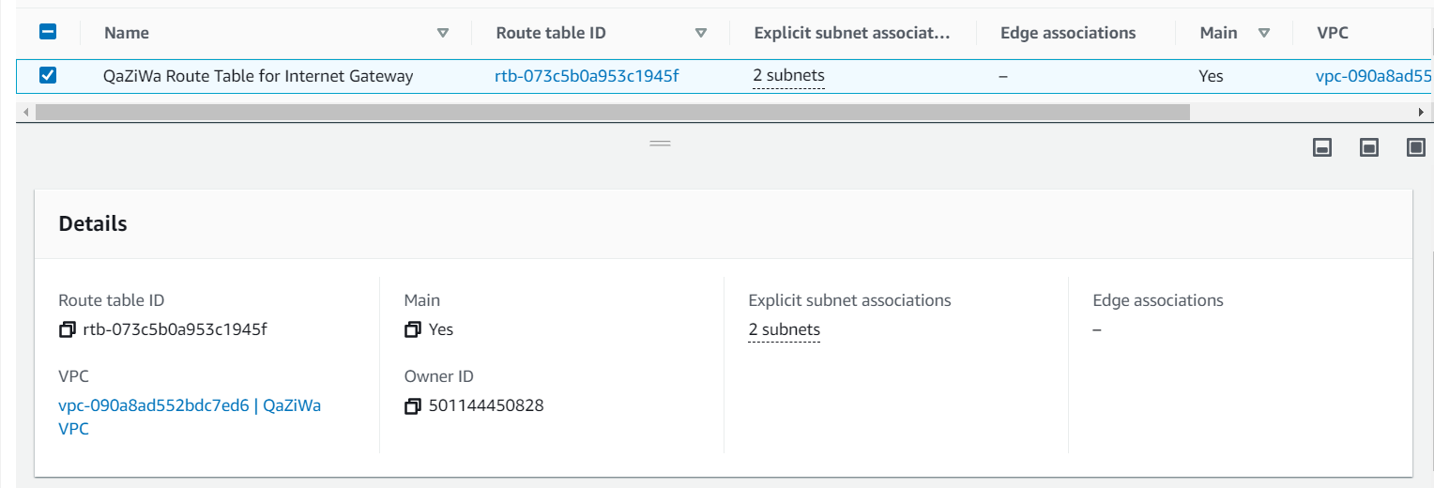
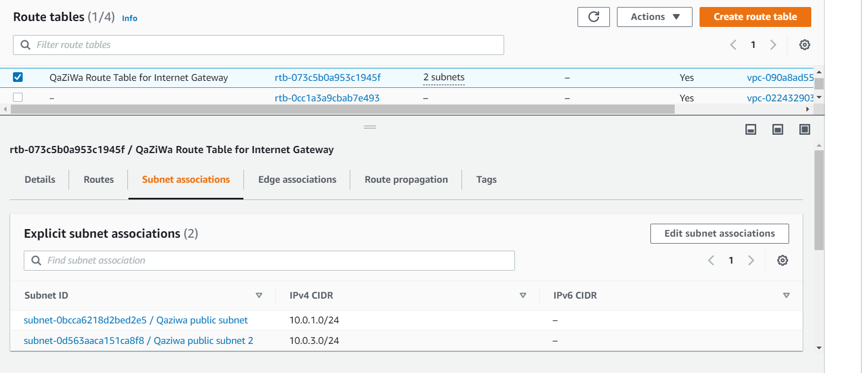
Cloud implementation (‘cont)
3. Route table to internet gateway

Slide 22
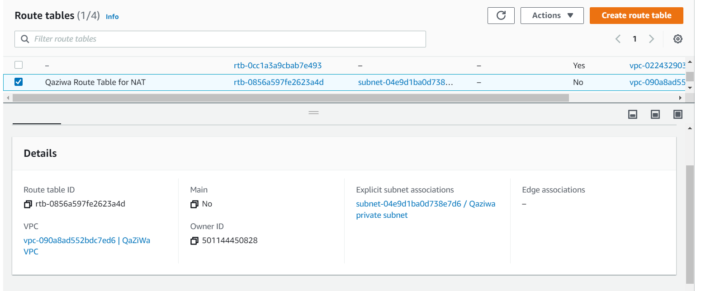
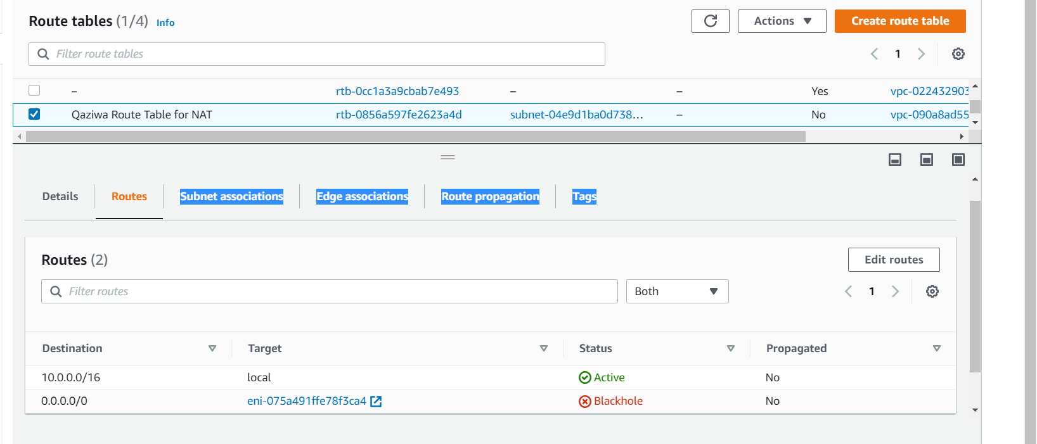
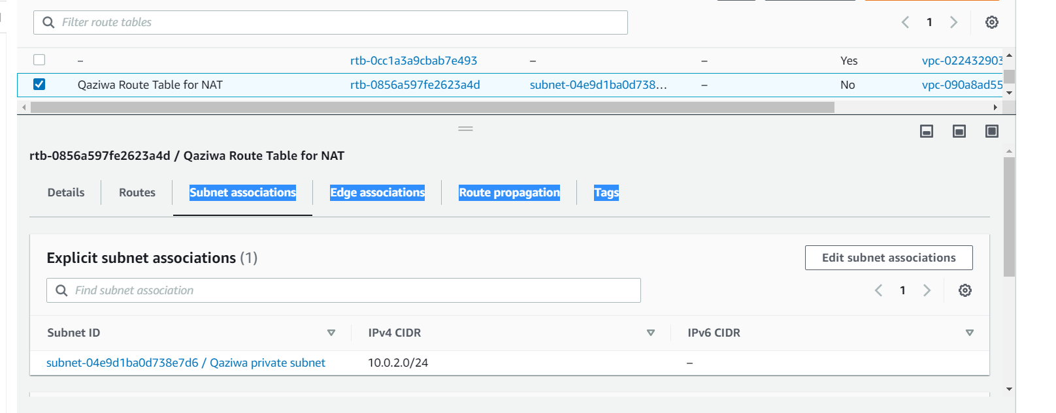
Cloud implementation (‘cont)
Route table to NAT instance

Slide 23
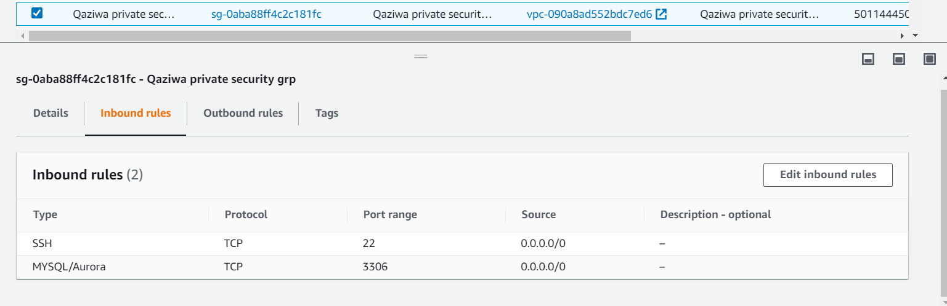
Cloud implementation (‘cont)
4. Security groups
Private security group
Only connects to database server, hence enable SSH for configuration and MySQL for connection to database.

Slide 24
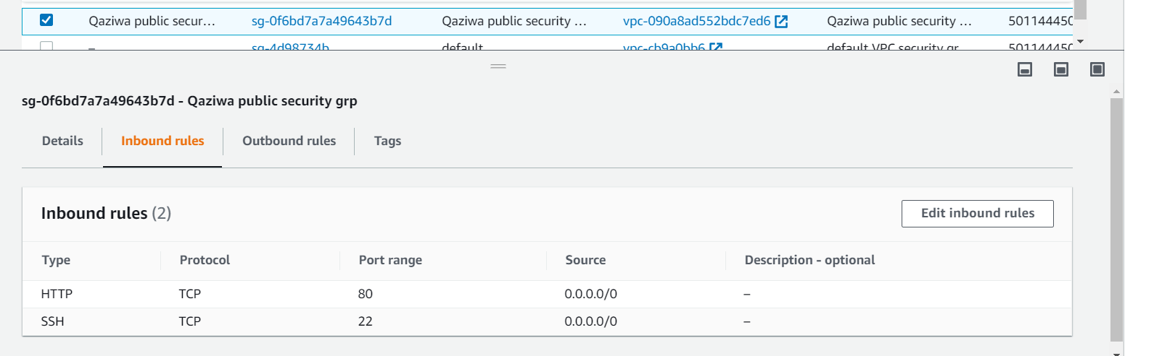
Cloud implementation (‘cont)
Public security group
Also connect to SSH and HTTP port for connection to web server.

Slide 25
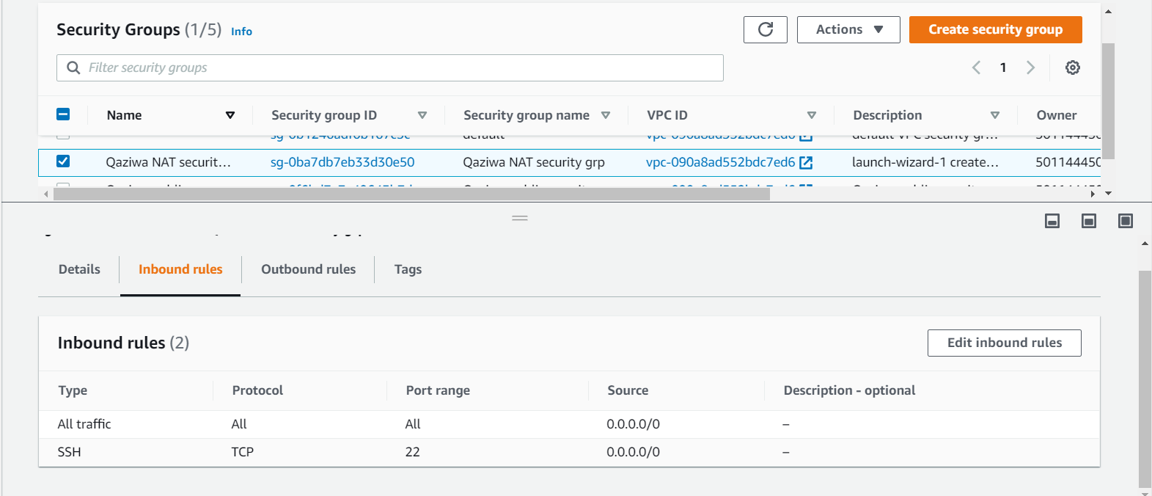
Cloud implementation (‘cont)
NAT security group
Enable all traffic as each NAT instance has their personal firewall or security rules.

Slide 26
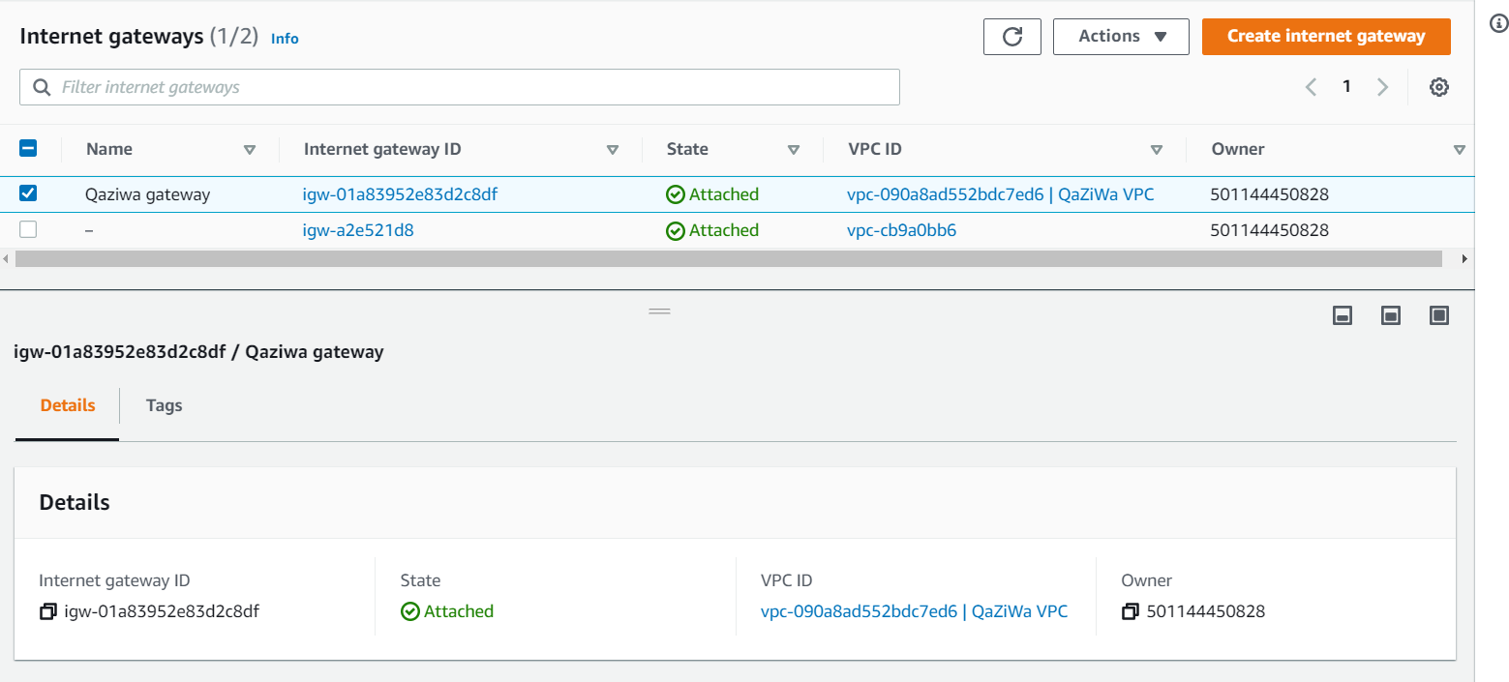
Cloud implementation (‘cont)
5. Internet Gateway

Slide 27
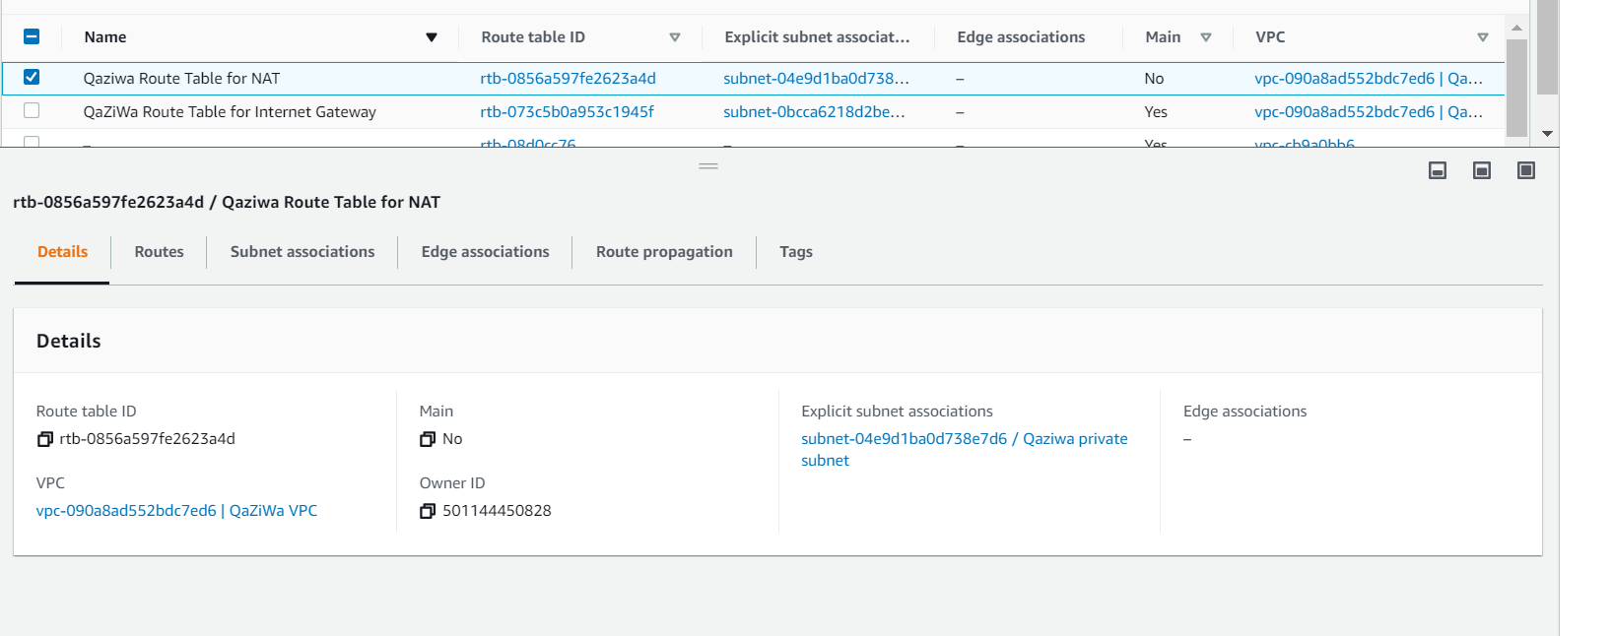
Cloud implementation (‘cont)
6. Instances
NAT instance
It enables the private IP address to connect to the internet while keep internet away from connecting to the private IP address. This ensure that database server is secured and accessible.

Slide 28
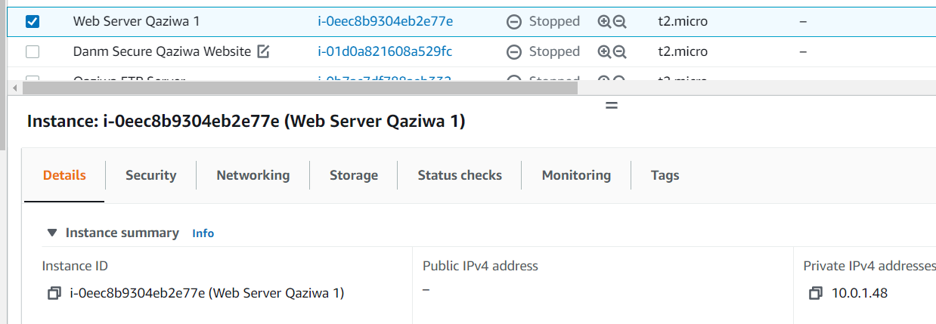
Cloud implementation (‘cont)
Web instance
Provide web services across all users to access the website and buy books. It is public facing where it user can access the website.

Slide 29
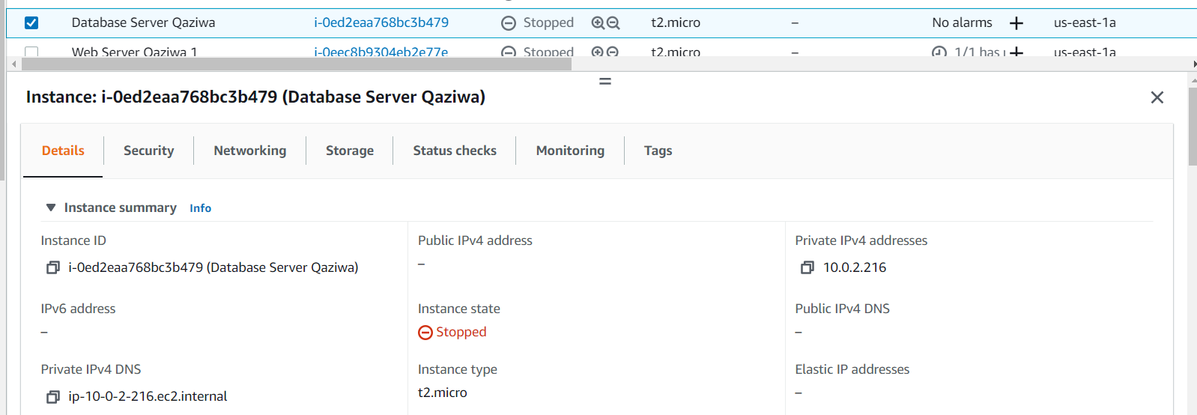
Cloud implementation (‘cont)
Database instance
Help to store records of the user, books and the cart where the user buy the books. It is internal facing in which no internet user can access the database server.

Slide 30
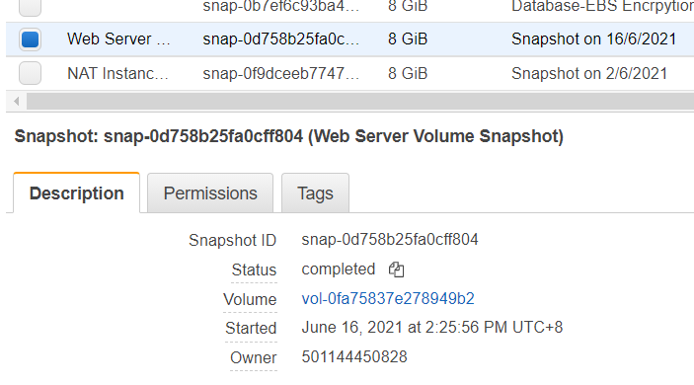
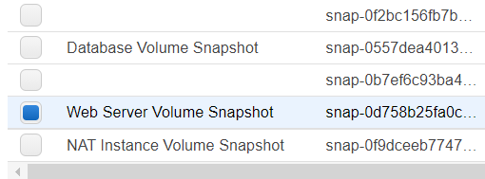
Cloud implementation (‘cont)
7. Snapshot
Volumes of NAT, Web & Database imaged
In the event of corruption new instance can be created with the volume of the either of this 3 pre-configured.

Slide 31
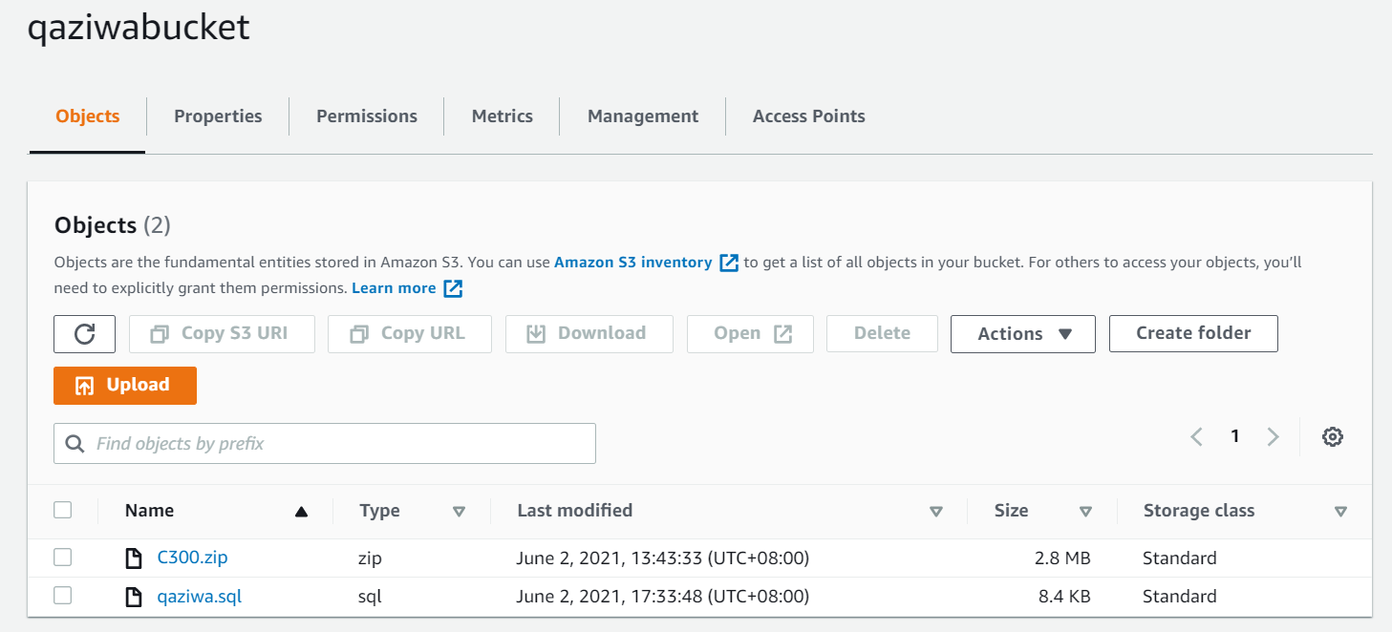
Cloud implementation (‘cont)
8. Storage (S3 bucket)
Unblock public access allowing public users to have access to web server instance.
Stores web code and Database template

Slide 32
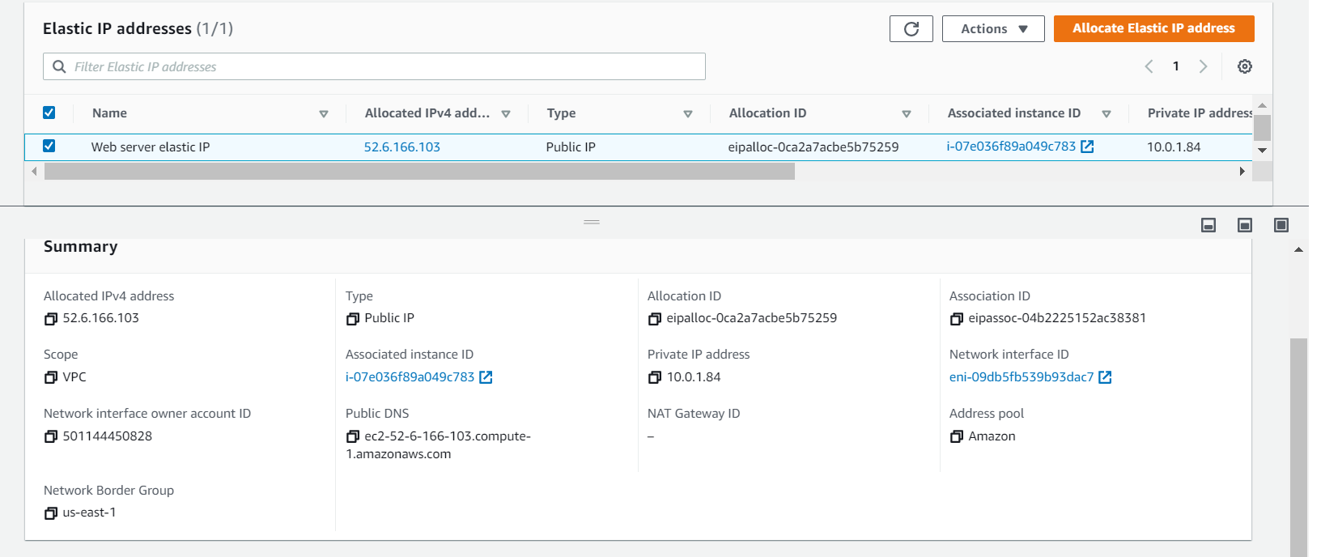
Cloud implementation (‘cont)
9. Elastic IP
Allocate elastic IP address for web server so the IP address will remains the same after every refresh.

Slide 33
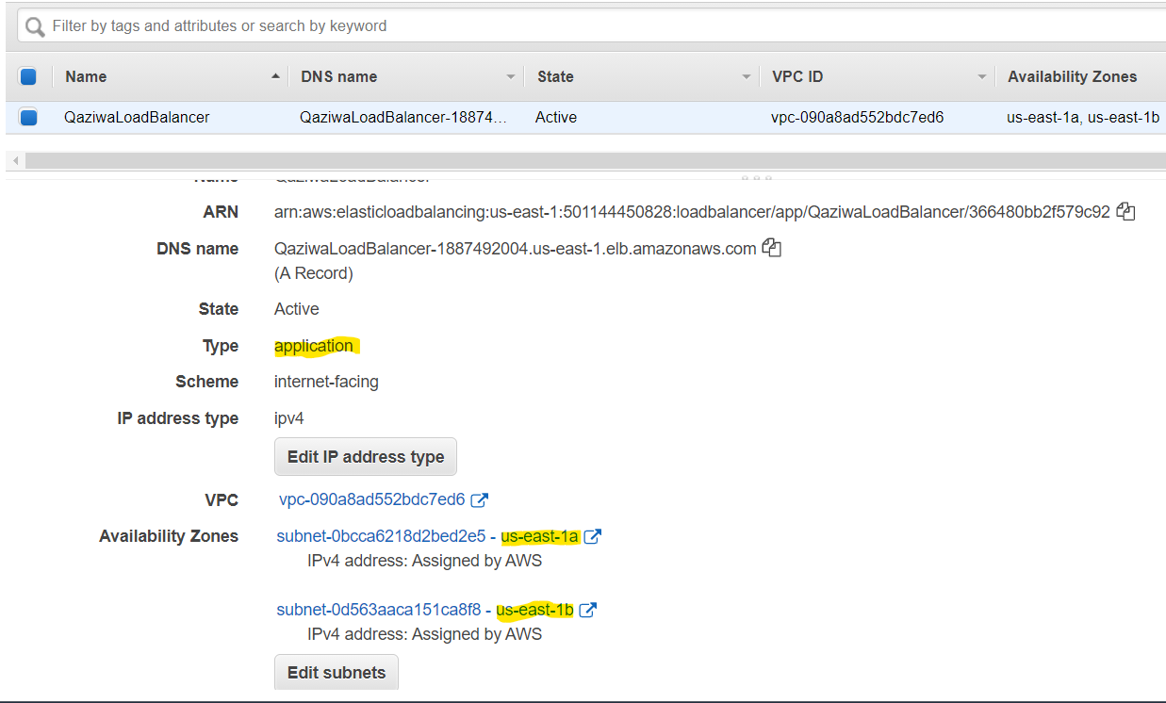
Cloud implementation (‘cont)
10. Application Load Balancer
Configured for Application type
Set for availability zone 1a & 1b

Slide 34
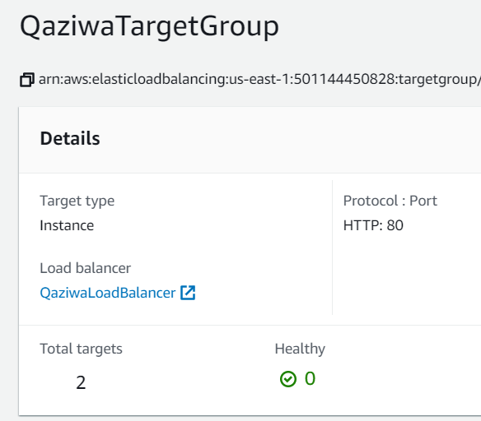
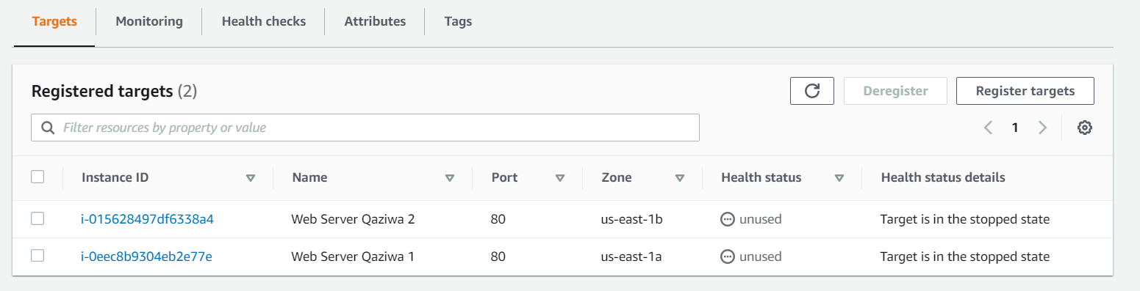
Cloud implementation (‘cont)
10. Application Load Balancer - Target groups
Web server 1 and Web Server 2 targeted for the Load Balancer
Target set to HTTP Port
Enable stickiness to keep session constant to that user

Slide 35
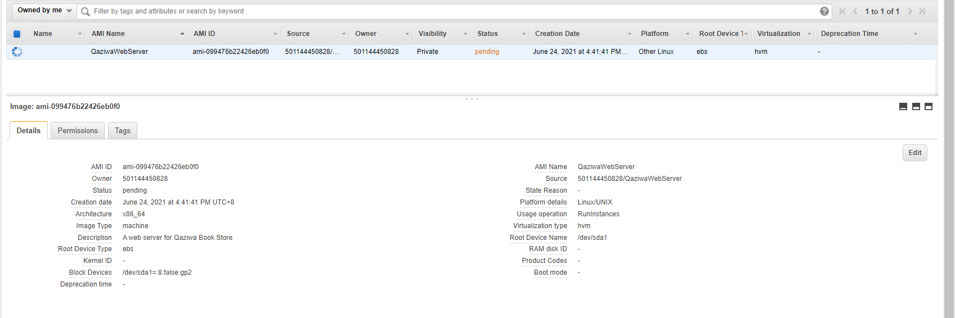
Cloud implementation (‘cont)
11. Auto scaling
Amazon machine image (AMI)
Create and activate AMI before configuring auto scaling.

Slide 36
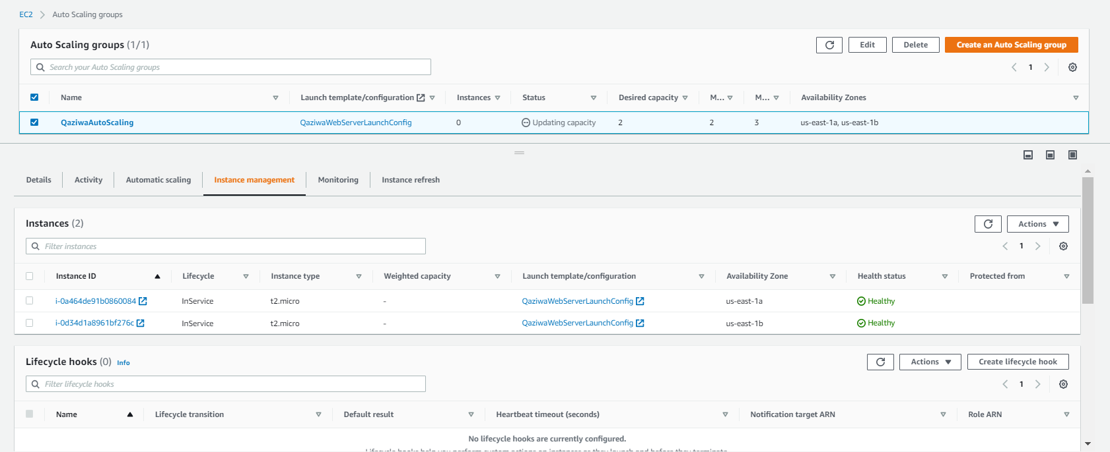
Cloud implementation (‘cont)
Auto scaling configuration

Slide 37
Security
12. Web security (Wafi)
No | Attack done/ Vulnerability found | Outcome (success/not success) | Mitigation(s)
1 | Session hijacking | success | session_regenerate_id() htmlspecialchars()
2 | Session fixation | success | session_regenerate_id()
3 | SQL injection | success | htmlspecialchars() PDO prepared statement
4 | Cross-site scripting | success | htmlspecialchars()
5 | DoS & DDoS | success | TimeOut MaxClients KeepAliveTimeout Implementation of Cloudflare
6 | Invalid or insufficient condition attack | success | Use session tokens
7 | Encrypted website (MITM) | success | HTTPS using Cloudflare

Slide 38
Security(‘cont)
Web security (Qamarrul)
No | Attack done/ Vulnerability found | Outcome (success/not success) | Mitigation(s)
8 | Brute force attack | success | Google Authenticator OTP generateRandomSecret() Strong password creation upon register
9 | Kill all session |  | session_destroy()
10 | Improper validation upload section | success | Validation form
11 | File inclusion attack | not success
12 | Showing of Apache Version and OS Identity | success | ServerSignature Off ServerTokens Prod
13 | Web server directory listing | success | Using Options directive
14 | Implementation of mod security |  | Mod security

Slide 39
Security(‘cont)
Web security (Zi Rui)
No | Attack done/ Vulnerability found | Outcome (success/not success) | Mitigation(s)
15 | Unnecessary HTTP request | success | LimitRequestBody
16 | Trace HTTP request | success | TraceEnable off
17 | Command injection attack | Not success
18 | Separate database and web server interfaces |  | Using private and public network/zone in AWS
19 | Exposed PHP version | success | expose_php = Off
20 | Redirect all traffic to pass through cloudflare | success | Change the security group in AWS
21 | Disable older version of TLS | success | Edit the TLS setting in cloudflare.

Slide 40
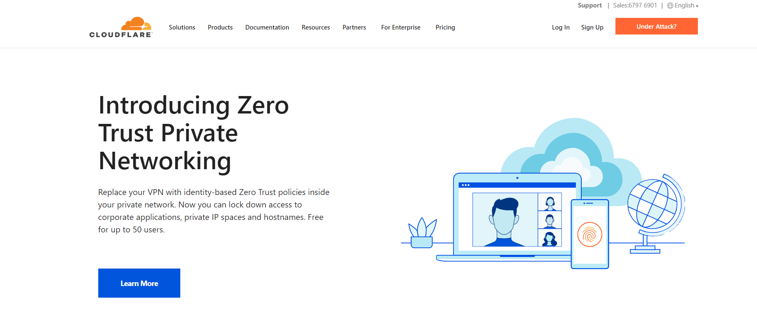
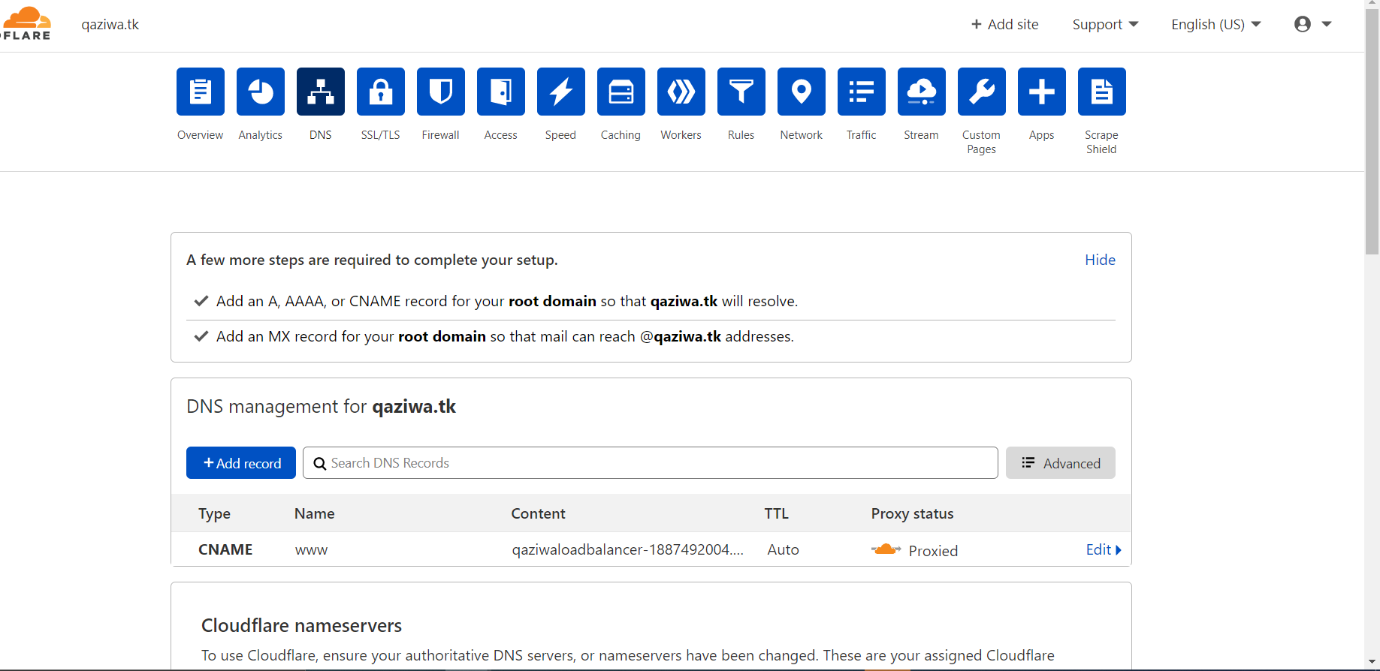
Security(‘cont)
13. CloudFlare
It even helps to improve the site performance and speed up loading time
CloudFlare offers a various range of protections such as SQL injection, Identity theft, DoS/DDoS protection

Slide 41
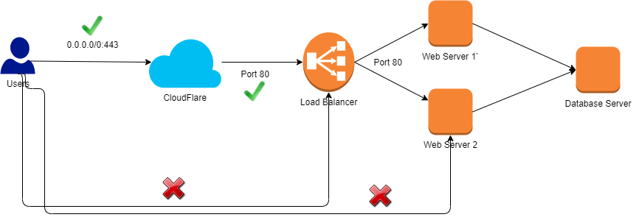
CloudFlare Summary network diagram

Slide 42
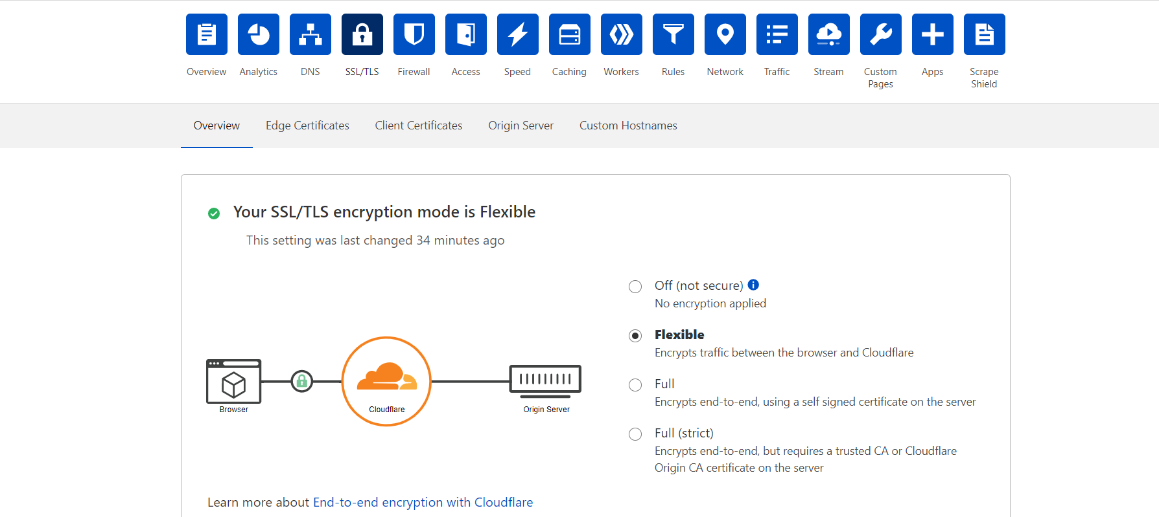


Ensure HTTPs from client to CloudFlare

Slide 43
Security (‘cont)
14. Google Authenticator
→ Implement a OTP QR code which change every pin (not a static QR code)
→ User need to download the google authenticator to use the function
→ Was motivated by OTP send via gmail account

Slide 44



Security (‘cont)
15. Rest Encryption (Database encryption)
We use innodb and plugins to encrypt our database and its tables.
Enable key rotation periodically (below)

Slide 45


Security (‘cont)
Rest Encryption (Database encryption)
Encryption of EBS volume for the database instance
Change from unencrypted volume to encrypted volume

Slide 46

Monitoring
16. Cloudwatch
Targeted to Load balancer, Auto Scaling, Instances
Monitors user connection count for user traffic
CPU consumption monitored, ensure load can handle

Slide 47


Monitoring (‘cont)
Cloudwatch Alarm
Configured alarms for targets monitored in CloudWatch
Set threshold based of data that was collected for the dashboard
Any alarms triggered would be notified via email

Slide 48

Monitoring (‘cont)
17. CloudTrail
Record activities performed in the AWS and logs it.
Logs are stored in a S3 bucket
Log file validation enabled, all files logged are hashed

Slide 49

Monitoring (‘cont)
Cloudtrail Email SNS
Configured for us to be notified when a new log is created
Email subscription follows the same as CloudWatch’s.

Slide 50


Allocation of privileges
18. IAM users

Slide 51



Allocation of privileges (‘cont)
Admin
Full privileges
Developer
Full access for instance & cloudwatch
Only read access for cloudtrail
Normal user
Only access to website

Slide 52

Allocation of privileges (‘cont)
19. KMS
KMS is a centralized zone for storing all cryptographic keys to protect data. It is integrated with CloudTrail for monitoring of the key usage from the logs to allocate required resources across the network.

Slide 53
Task Allocation and Progress
Wafi
Task | Progress
Website Planning | 100%
Finalised website design | 100%
Listing Page (Website) | 100%
Cart Page (Website) | 100%
Google Authenticator | 100%
Route Table | 100%
Subnet Creation | 100%
Auto Scaling | 100%
Continue Next Few Slides ->

Slide 54
Task Allocation and Progress
Wafi
Task | Progress
Domain Name | 100%
Cloudflare | 100%
FTP Server | 100%
Internet Gateway | 100%

Slide 55
Task Allocation and Progress
Zi Rui
Task | Progress
Website Planning | 100%
Use-Case Diagram | 100%
Login Page (Website) | 100%
Checkout Page (Website) | 100%
Registration Page (Website) | 100%
Confirmed Payment Page (Website) | 100%
Database Implementation (Cloud) | 100%
NAT Implementation | 100%

Slide 56
Task Allocation and Progress
Zi Rui
Task | Progress
KMS | 100%
CloudTrail | 100%
VPC Creation | 100%
Elastic IP | 100%

Slide 57
Task Allocation and Progress
Qamarrul
Task | Progress
Database Planning | 100%
ERD Diagram | 100%
Database Structure (phpMyAdmin) | 100%
Database Creation | 100%
Table Creation (Content) | 100%
Web Server Implementation | 100%
Snapshot Instances | 100%
S3 Bucket | 100%

Slide 58
Task Allocation and Progress
Qamarrul
Task | Progress
Load Balancing | 100%
IAM Roles | 100%
CloudWatch | 100%
Database (Rest) Encryption | 100%

Slide 59
Records of Team Meetings with Supervisor
Name | 21 April 2021 | 28 April 2021 | 19 May 2021 | 2 June 2021 | 16 June 2021 | 23 June 2021 | 7 July 2021
Wafi | Present | Present | Present | Present | Present | Present | Present
Zi Rui | Present | Present | Present | Present | Present | Present | Present
Qamarrul | Present | Present | Present | Present | Present | Present | Present
Note: For meetings without the presence of supervisor, the team meets every Wednesday and Friday with each member present for every meeting
continue next page

Slide 60
Records of Team Meetings with Supervisor
Name | 14 July 2021 | 28 July 2021 | 4 August 2021
Wafi | Present | Present | Present
Zi Rui | Present | Present | Present
Qamarrul | Present | Present | Present
Note: For meetings without the presence of supervisor, the team meets every Wednesday and Friday with each member present for every meeting

